Slide 1



Tesla Motors
Why you should consider a Tesla for your next car
Notes:
Tesla logo: https://logoepscdnphoto.b-cdn.net/wp-content/uploads/2013/02/tesla-motors-logo.png
Background: https://alfa-img.com/show/white-and-red-background-images.html

Slide 2
Outline
The Environment
Better for the environment!
Features
It’s a car but so much more!
Price
Not as expensive as you’d think!

Slide 3
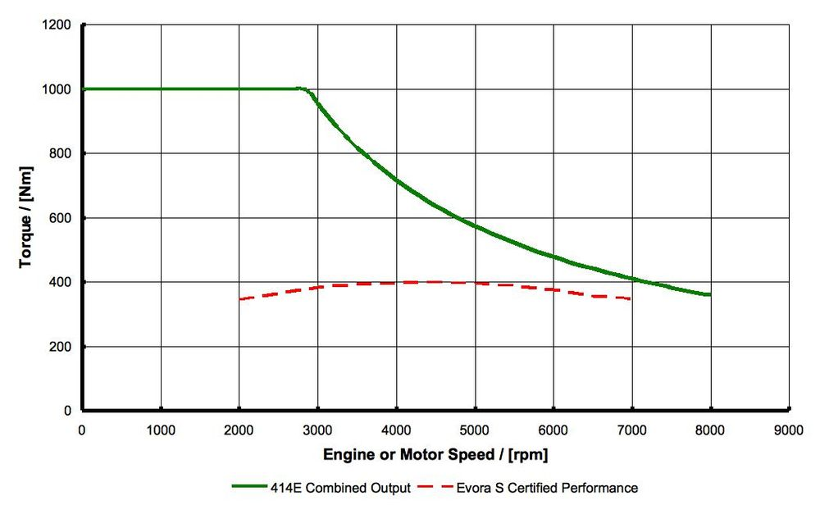
The Environment
Zero Emissions
Electricity
“You have enough electricity to power all the cars in the [US] if you stop refining gasoline” –Elon Musk, Tesla Motors Inc.
Aluminum vs Steel
Efficiency
“Electric engines can be more than 90% efficient and even up to 98% efficient” -Nathan Kaemingk, Technical Specialist for Cummins Inc.
Notes:
Talking notes:
Zero Emissions:
-Tesla cars don’t use gas, they use electricity, it’s the main reason everyone’s hyped about EV’s
-Electricity is relatively easy to clean up after. You don’t have to deal with disasters like oil spills.
“Refining Gas Uses More Electricity Than Electric Cars”
-But wait generating electricity has a carbon footprint!
Yes, it does. However, refining gas actually uses more electricity than refining gas. In a video interview with Elon Musk, an American Documentary filmmaker named Chris Paine mentions that it takes
“4 to 6 kilowatt hours of electricity to refine every gallon of gasoline”, not including transportation costs. Elon Musk reinforces that statement saying that
“You take an average of 5 kilowatt hours to refine gasoline, something like the Model S can go 20 miles on 5 kilowatt hours. You basically have the energy needed to power electric vehicles if you stop refining. “ –Elon
http://www.businessinsider.com/elon-musk-and-chris-paine-explain-how-the-electric-car-got-its-revenge-2011-10
Aluminum vs steel
The Tesla Model S has an aluminum frame, and the Model 3 uses an aluminum alloy.
Aluminum may be more expensive than steel. But, in the long run it’s better, because aluminum is very light compared to other metals. This makes cars overall lighter, which in turn means that less energy is needed to actually move, which is what cars are made to do.
“A fleet of aluminum vehicles saves the equivalent of 44 million tons of CO₂ emissions.”
https://www.thermofisher.com/blog/metals/aluminum-a-potential-weapon-in-the-fight-against-greenhouse-gas-emissions/
https://electrek.co/2017/08/22/tesla-model-3-body-alloy-mix/
Electric motors vs gas motors graph (Lotus, so high end cars)
Electric induction motors, produce significantly more torque than an internal combustion engines due to their design.
And as we know, torque is the force we need to turn the wheels in a car.
A traditional gas engine needs to actually be running at a certain amount of revolutions per minute before it can even provide torque.
Not only that, there is a delay before it reaches its maximum torque, which gets smoked by the amount of torque an electric engine can provide, starting from rest
Additionally, Electric engines are extremely efficient. A good combustion engine can be 30-45% efficient
But an electric engine can be 90% and even up to 98% efficient
https://www.carthrottle.com/post/how-do-electric-vehicles-produce-instant-torque/
https://www.quora.com/How-energy-efficient-are-electric-motors-compared-to-combustion-engines

Slide 4
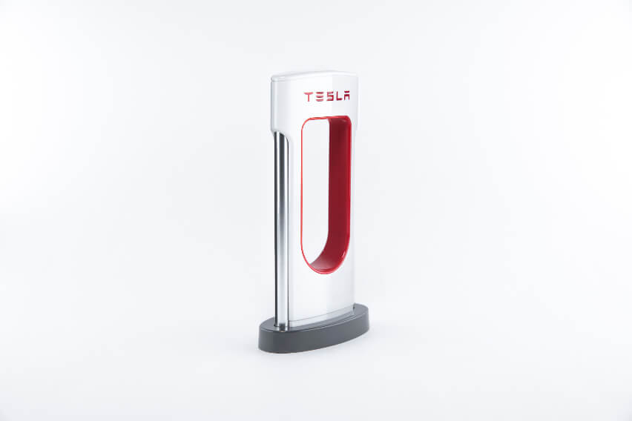
Features
Auto-Pilot Mode
Over the Air Updates
Supercharger Stations
"average Supercharging session lasting around 45-50 minutes"
Auto-raising Suspension
Controls Compressions and Height
Notes:
https://www.cnbc.com/2017/11/17/tesla-model-s-best-features.html
https://www.theverge.com/2017/1/12/14257914/tesla-supercharger-cost-electric-car-charging
https://www.tesla.com/en_CA/support/supercharging

Slide 5
Price
Relatively Inexpensive
Model 3 expected to cost $45,000
Significantly cheaper fuel
Save 80% using electricity instead of gas
Income Tax Rebates
Residents of Ontario may receive up to $15,000 in rebates
Notes:
https://www.greencarreports.com/news/1080871_electric-car-price-guide-every-2015-2016-plug-in-car-with-specs-updated
https://www.tesla.com/en_CA/where-you-park
https://www.tesla.com/en_CA/support/incentives

Slide 6
Conclusion
The Environment
Electricity is better than gas in the production and distribution stages
Features
Autopilot mode
Auto-raising air suspension
Superchargers
Price
Quite affordable + long-term savings

Slide 7
Questions?

